Slide 1
Data Analysis Challenge
Ultimate Technologies Inc.
Yuka Abe 3/30/2019

Slide 2

Background
Ultimate Technologies Inc. is an American worldwide online transportation network company that has disrupted the taxi and logistics industry and is a prestigious companies to work at. This challenge has been adapted from an actual Ultimate Inc. data science challenge.

Slide 3
Data Analysis Challenge: Part One
Exploratory data analysis on USER Login Timestamp

Slide 4
Part One Challenge Background
Download (simulated) timestamps of user logins data in a particular geographic location
Aggregate these login counts based on 15­ minute time intervals, and visualize and describe the resulting time series of login counts in ways that best characterize the underlying patterns of the demand.
Please report/illustrate important features of the demand, such as daily cycles. If there are data quality issues, please report them.

Slide 5
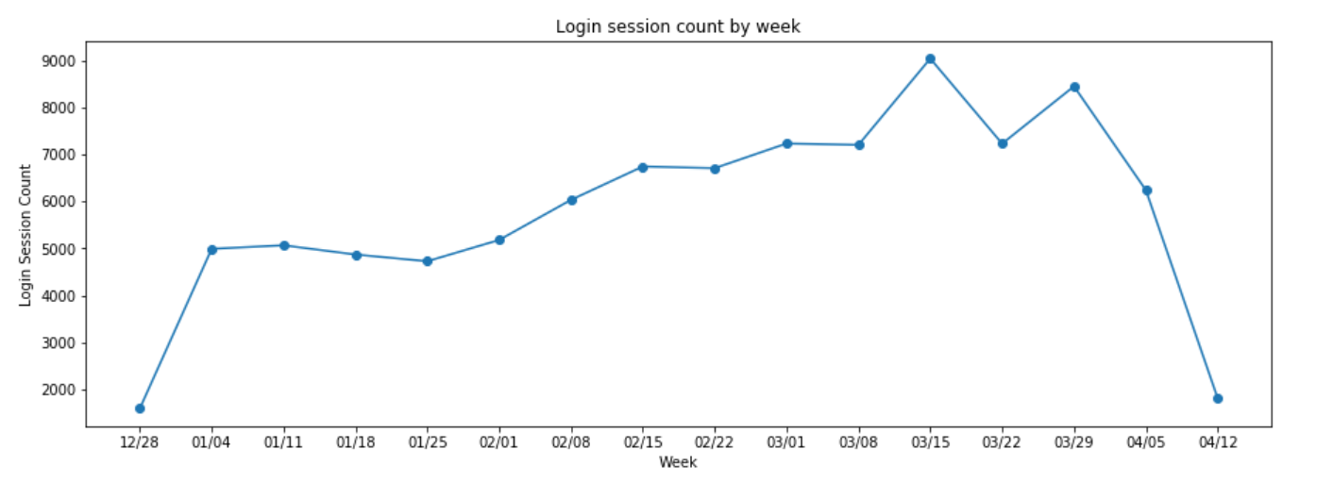
Solutions: Login Sessions By Week
Usage of app in that specific location has an upward trend from January till end of March.
However the usage is going down during the latest weeks in April.
Need to look into systems to see if the dip in April is caused by any data/system issue.

Slide 6
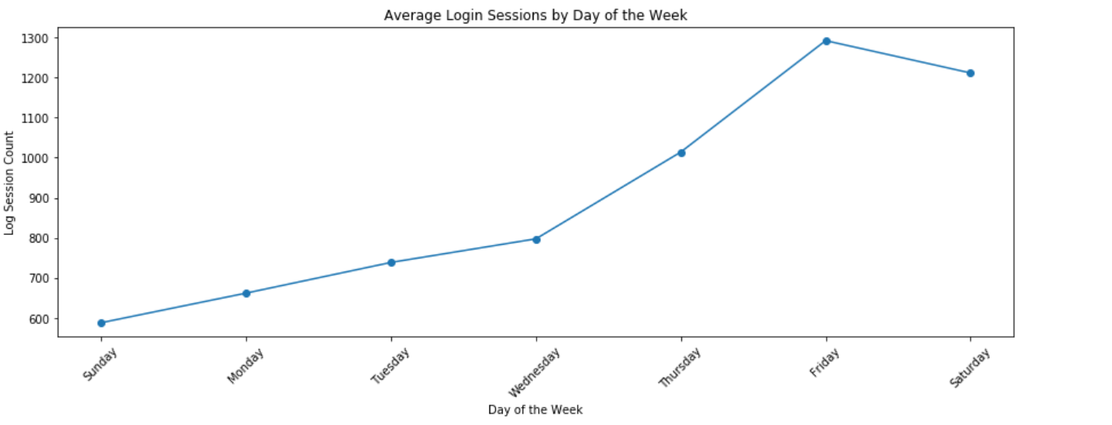
Solutions : Login Sessions by Day of the Week
The closer towards the weekends, the more demands for taxis in that location.

Slide 7
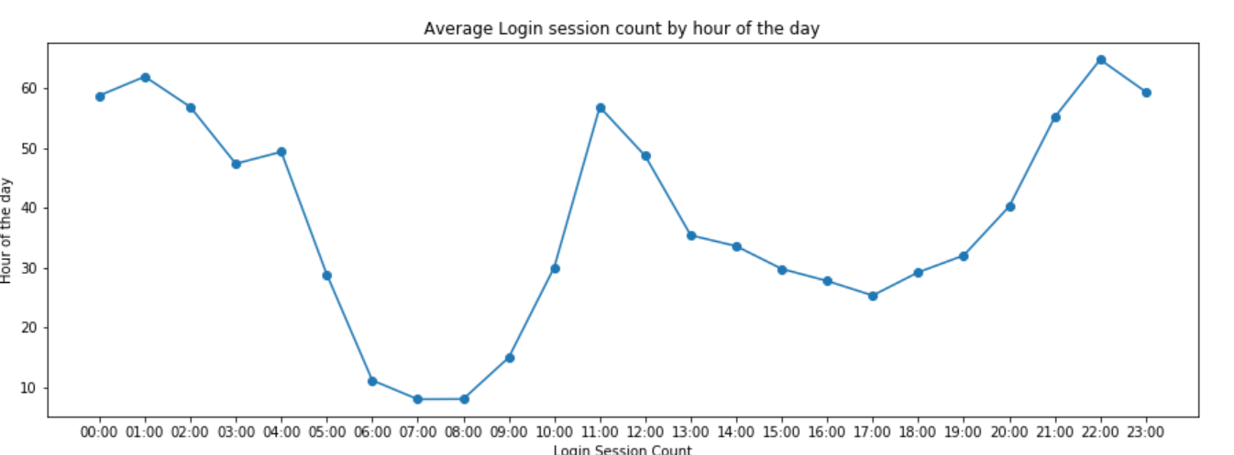
Solutions: Login Sessions By Hour of the Day
The peak hours for the app: 10 pm - 1 am
off-peak hours: 6 am - 9 am

Slide 8

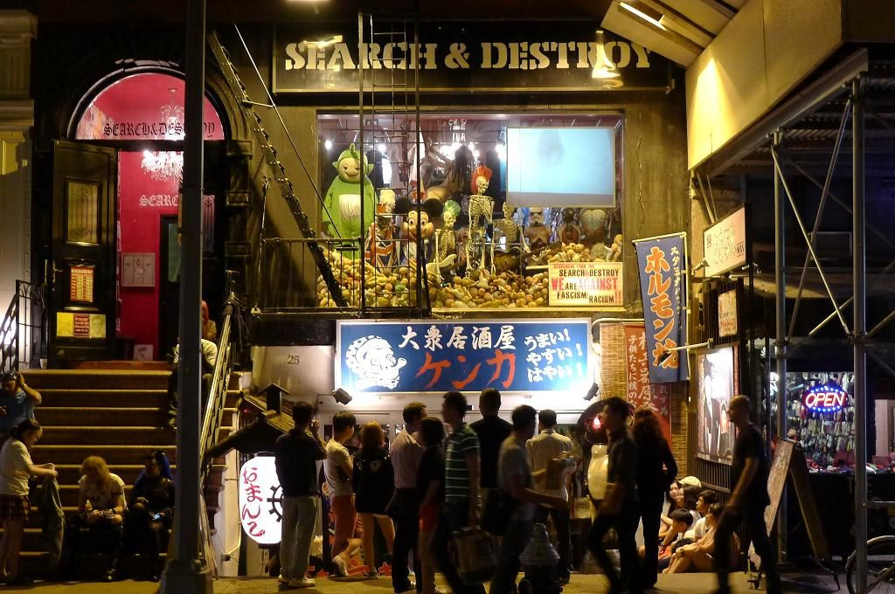
What Geo Location could the data be collected?
The location might be a dynamic neighborhood full of entertainment, restaurants and nightlife (example: East Village, Lower East Side in NYC)

Slide 9
Data Analysis Challenge: Part Two
Experiment and metrics design

Slide 10
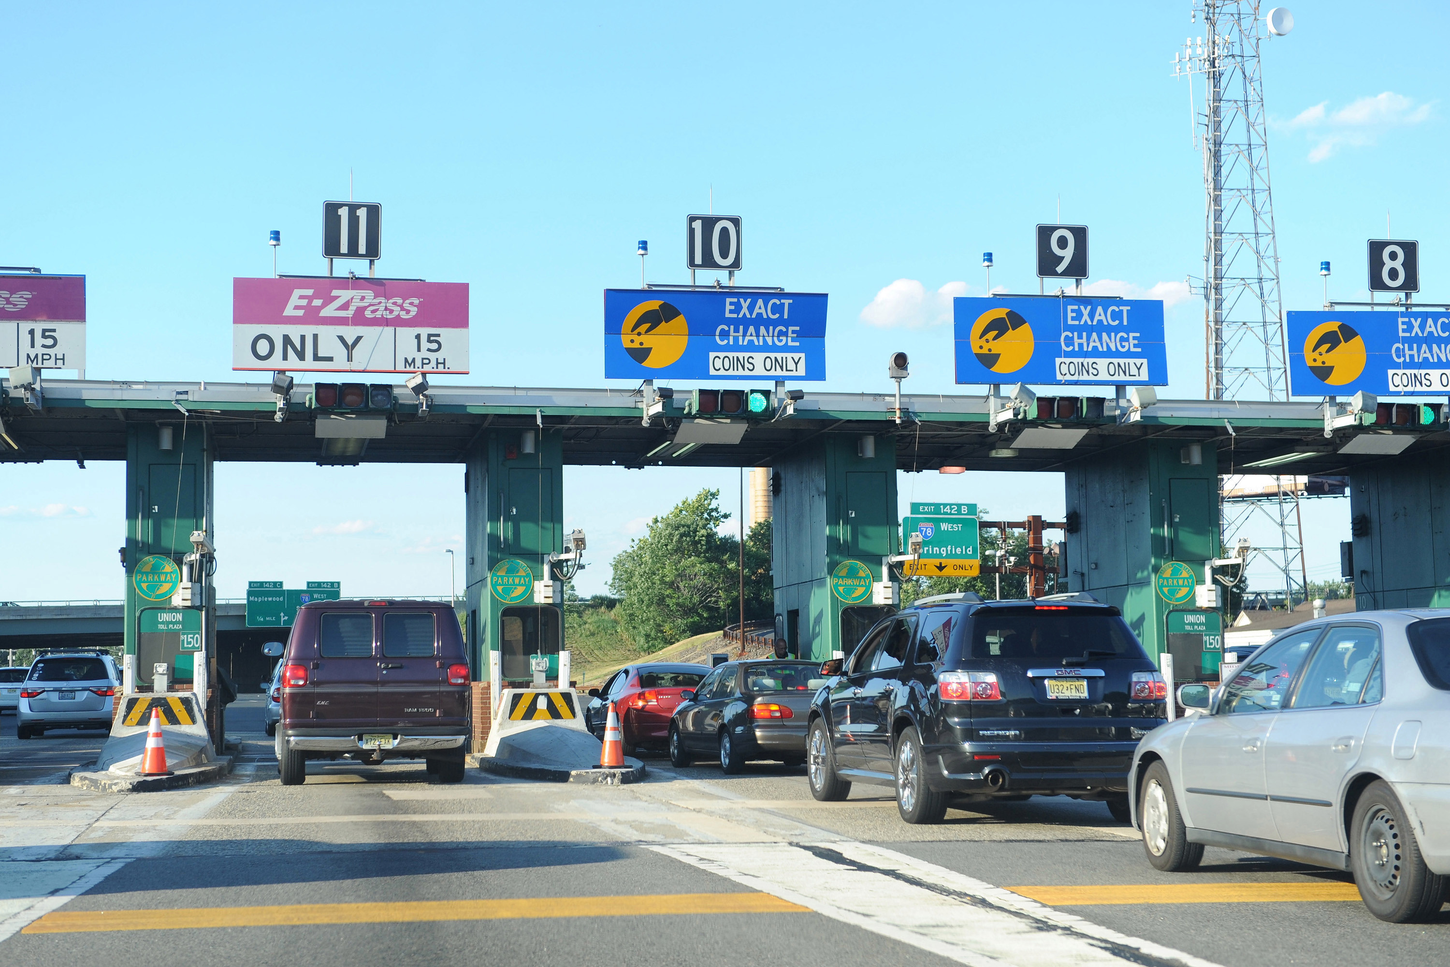
Part Two Challenge Background
Background information
The neighboring cities of Gotham and Metropolis have complementary circadian rhythms. However, a toll bridge, with a two ­way toll, between the two cities causes driver partners to tend to be exclusive to each city. The Ultimate managers of city operations for the two cities have proposed an experiment to encourage driver partners to be available in both cities, by reimbursing all toll costs.

Slide 11
Part Two Challenge Background
Questions:
What key measure of success will you choose of this experiment in encouraging driver partners to serve both cities, and why would you choose this metric?
Describe a practical experiment you would design to compare the effectiveness of the proposed change in relation to the key measure of success.

Slide 12
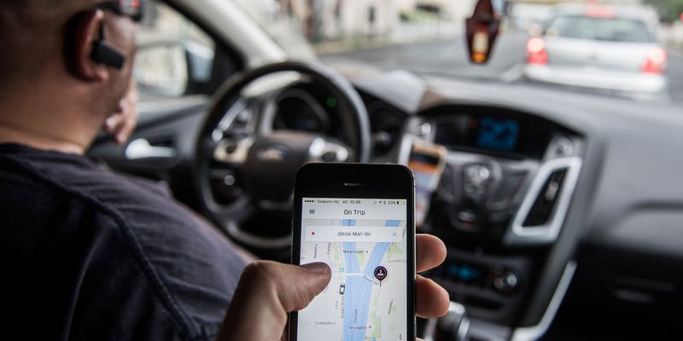
Solution: Key Metric
Key Metric: Trip fulfillment rate in the other city by the driver partners working in these two cities
Trip fulfillment Rate = # Trips fulfilled by driver partners in the other city / total # trips fulfilled by driver partners
Hypothesis: After the new toll reimbursement policy gets rolled out, the probability of the driver partners to fulfill the trips in the other city will increase.

Slide 13
Solution: Test Design
A/B testing: Pick two groups of driver partners working mostly in one of the cities. (one as control, the other as experiment)
The testing groups should meet with the following requirements:
Usually active during peak hours of both cities
Have similar weekly working hours and driving miles
Each group should have a representative proportion of driver partners from both cities
Control group will not receive reimbursement for toll fee. Experiment group will get notification on the new toll reimbursement policy.
A/A test: Check if the key metric is robust enough before doing the test.
Test duration: at least one month for driver partners to get adapted to the new policy.

Slide 14
Solution: Test Read & Interpretation
Statistical test:
Use Z test to compare fulfillment rate given the testing population is large enough
Use One-tail test since we only care about whether the new change has positive effect
Test result interpretation:
Stats significant result: The policy is actually working. Keep ramping up the test
No stats significant result: Post-test study/survey to get drivers’ feedback
Additional recommendations:
Keep track of the actual demand fulfillment rate when ramping up the test to understand whether customers actually need extra supply for drivers outside of the city
Demand fulfillment rate = # driver supply/ # requests made by customers in both cities.
Track revenue driven by the change as opposed to the increase in cost to ensure the profitability of the new policy

Slide 15
Data Analysis Challenge: Part Three
PREDICTIVE mODELING

Slide 16
Part Three Challenge Background
Data provided: Sample data of a cohort of users who signed up for an Ultimate account in January
Objective:
Predict rider retention 6 months after users signed up
Understand what factors are best predictors for retention
Offer suggestions to operationalize the insights to help Ultimate
Definition of active user: consider a user retained if they were “active” (i.e. took a trip) in the preceding 30 days
Deliverables:
Build predictive model to determine whether a user will be active in their 6th month on the system
Discuss why you choose you approach and how valid your model is
Leverage insights gained from model to improve its long-term rider retention

Slide 17
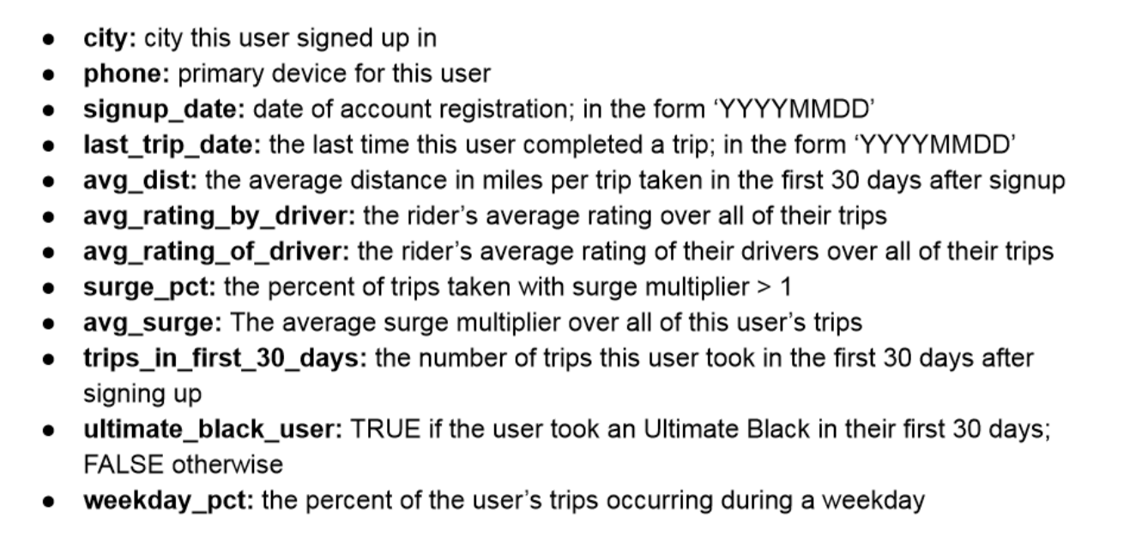
Part Three Challenge Background
Data Description

Slide 18
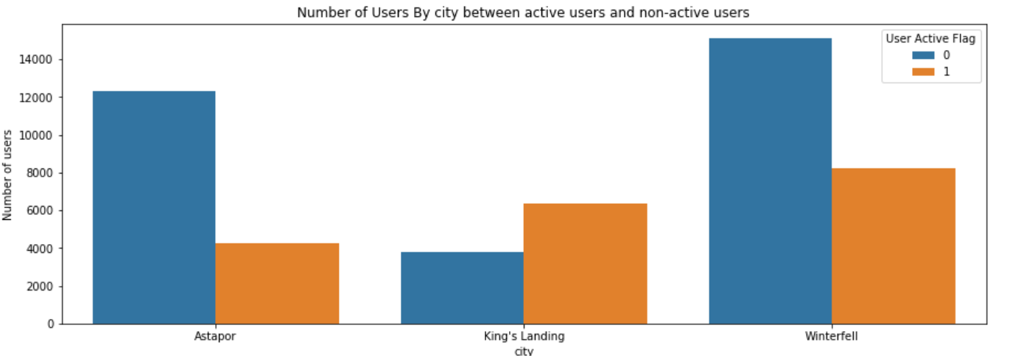
Solution: Exploratory Data Analysis
Users who signed up in King's landing are more likely to be retained.

Slide 19
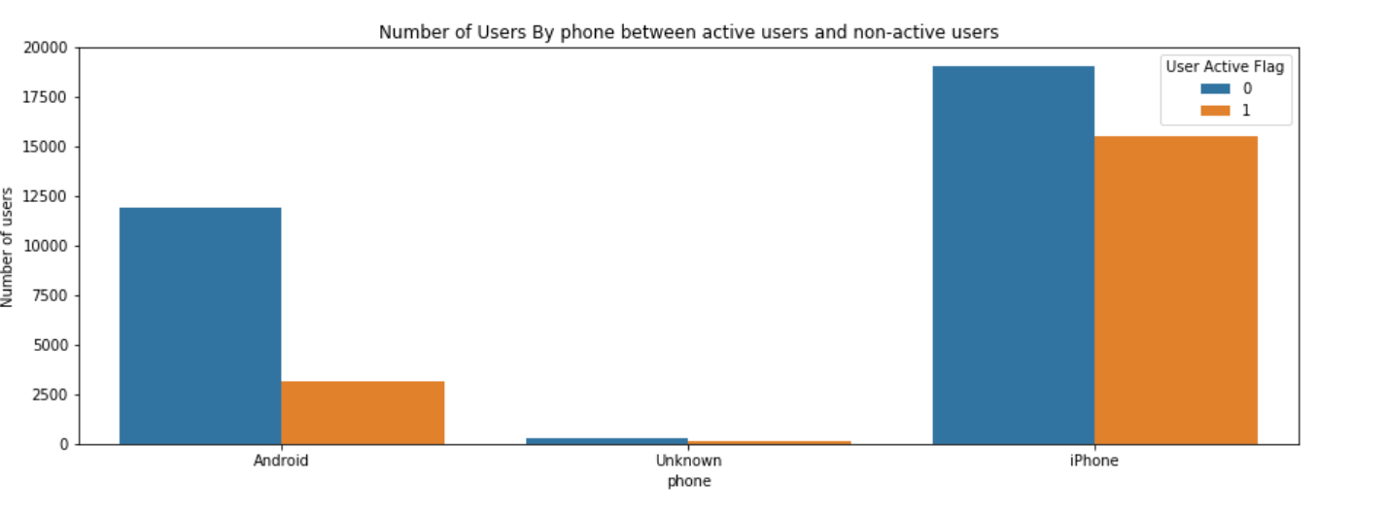
Solution: Exploratory Data Analysis
Android users are less likely to be active users after 6 months.

Slide 20
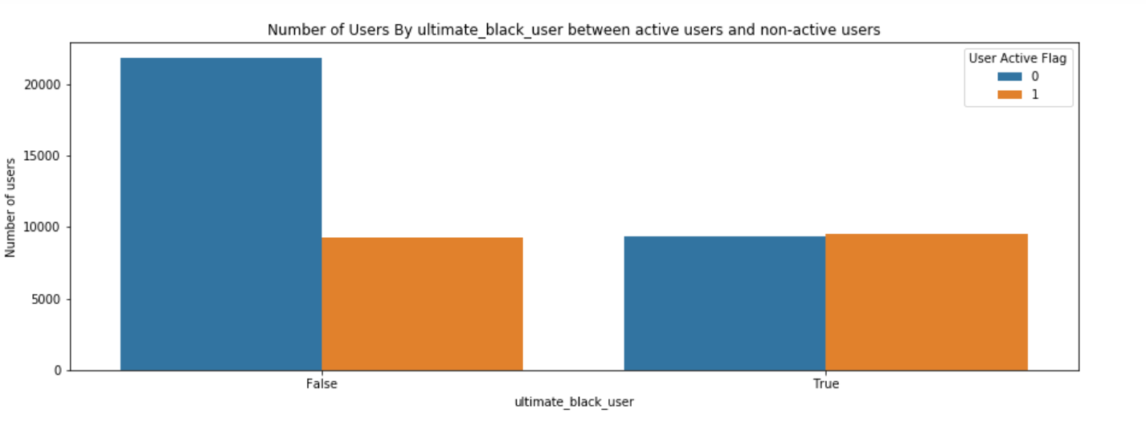
Solution: Exploratory Data Analysis
Users who did not take an Ultimate Black in their first 30 days are less likely to be retained users.

Slide 21
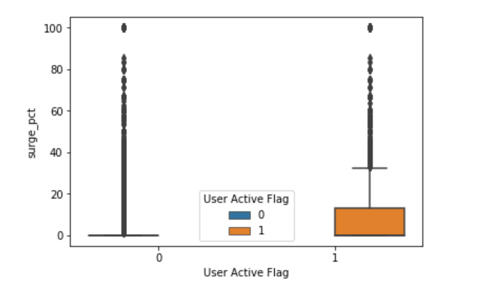
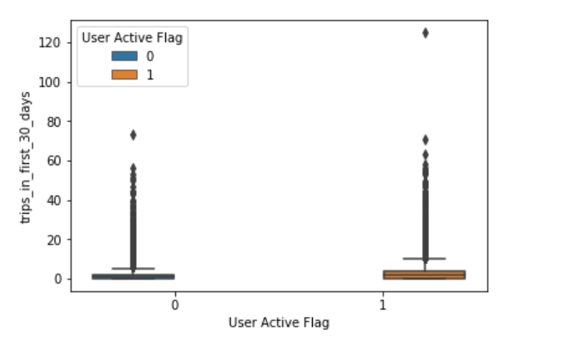
Solution: Exploratory Data Analysis
Active users took slightly more trips in their first 30 days.
Active users have taken more of the trips with surge multiplier compared with inactive users.
Percentage of trips with surge multiplier
Trips in the first 30 days

Slide 22
Solution: Classification Model
Label: Active User Flag (Y/N)
Features: User attributes in the dataset such as city, average rating on driver, etc.
Models used: Logistic Regression & Random Forest Classifier
Logistic Regression is more interpretable as it gives insights on the weight of each feature on the user retention probability.
Techniques used:
Log transformation on highly skewed variables
One hot encoding on categorical variables
Adjust coefficients through regularization (Ridge) to avoid overfitting
Random Forest Classifier is less interpretable but it gives more accurate predictions, avoids overfitting and also provides insights on feature importance.
Techniques used: Randomized Search and Grid Search for hyper-parameter tuning

Slide 23
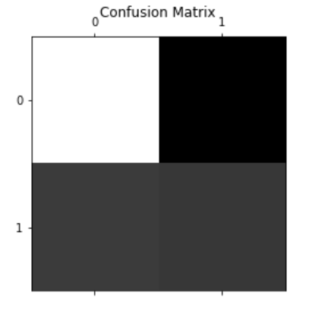
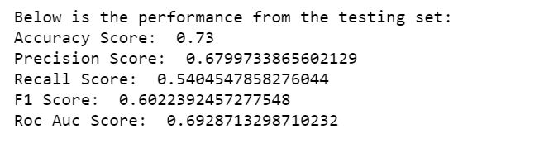
Solution: Logistic Regression Model
Model Performance
The model has a good accuracy score and ROC AUC score since that data has unbalanced classes.
The recall score looks low, which means the model will have problem capturing real active users that are likely to be retained.

Slide 24
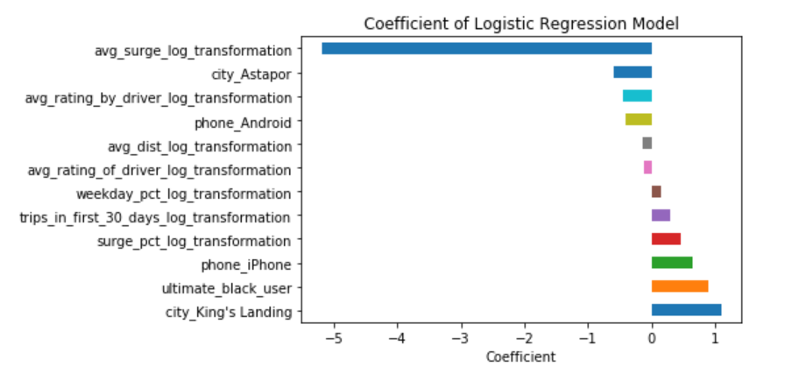

Solution: Logistic Regression Model
Top positive features: “King’s landing” signup place, “Ultimate Black” usage and iPhone user device
Top negative features: Average surge multiplier usage over all of users’ trips

Slide 25
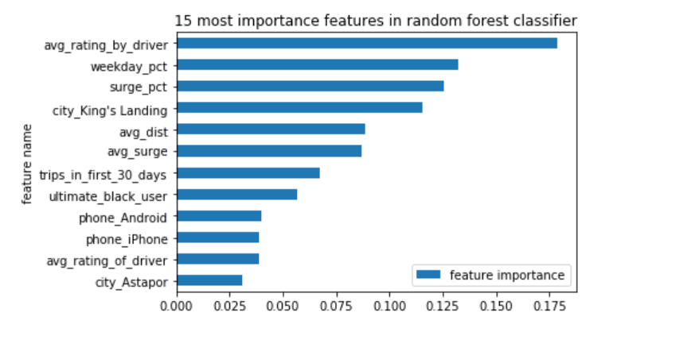
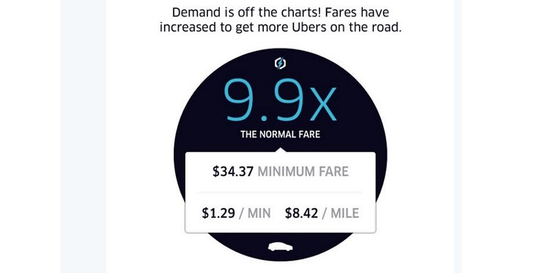
Solution: Random Forest Classifier
Top positive features: Average rating by driver, Percentage of weekday trips over all trips, Percentage of trips using surge multiplier over all trips

Slide 26

Solution: Business Insights & Recommendation
Use the retention probability to score the new users: promote referral program towards high-quality users & reduce initial acquisition cost on low-quality users
Spend more marketing budget for targeting at iPhone users at King’s Landing for marketing acquisition

Slide 27
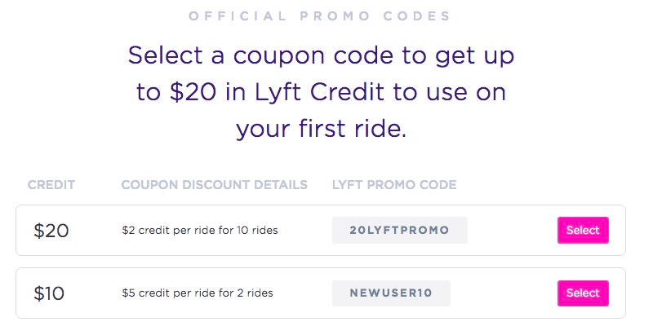
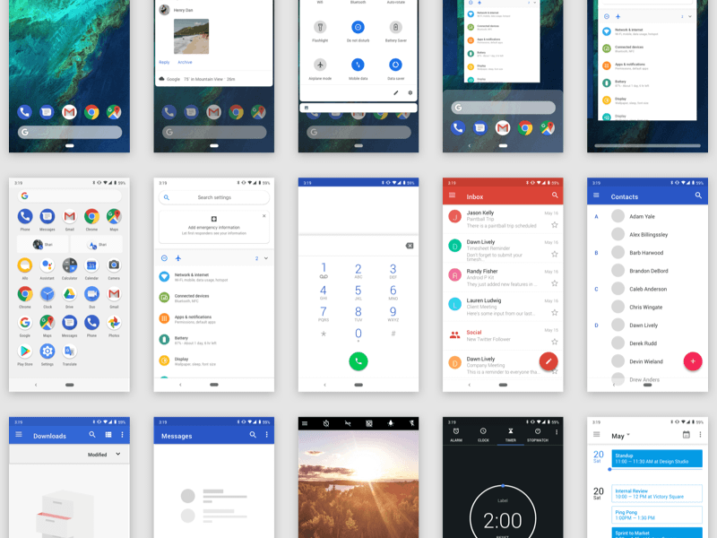
Solution: Business Insights & Recommendation
Improve UI experience of the Android app
Experiment on promotions to motivate users to use more of the app during their first 30 day trial
Adjust the pricing and user experience of surge multiplier function for long-term user retention

Slide 28
THANK YOU
More details on github: https://github.com/yukaabe/Data-Science-Projects-Portfolio-Repo/tree/master/Data%20Analysis%20Take%20Home%20Challenge%20Ultimate%20Technologies
Notes:
https://github.com/yukaabe/Data-Science-Projects-Portfolio-Repo/tree/master/Data%20Analysis%20Take%20Home%20Challenge%20Ultimate%20Technologies

